Slide 1

The UN Development System
The Future of the United Nations Development System (FUNDS) Project
The case for reform
Stephen Browne
Geneva, 14 November 2012

Slide 2
What is the “UN”? Four pillars
Justice &
Human rights
Peacekeeping
60% of permanent staff
$13-15 billion p.a.
Humanitarian
Development
      Inter-governmental cooperation & policy
      Technical standards & norms
      Research, data & information
      Technical assistance

Slide 3
Is UN Development a “System”
UN Charter chapter X: “International Economic and Social Cooperation”
Medium and long-term development objectives
“Operational”: member of the UN Development Group
MDGs

Slide 4
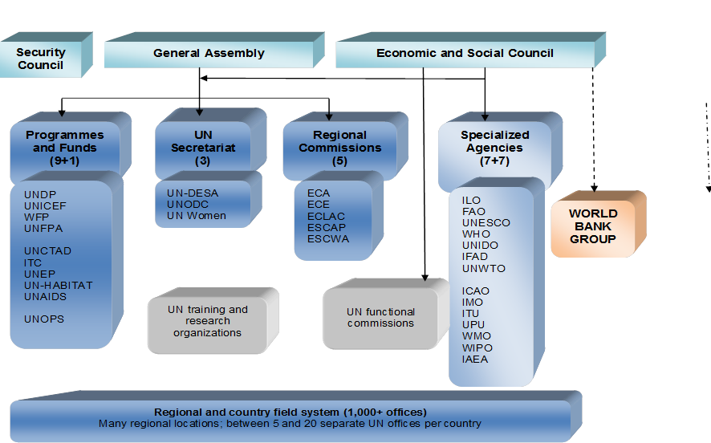
The UN Development System today

Slide 5
UN Development’s 3 challenges
Organizational incoherence
Growing irrelevance
Vested interests

Slide 6
Who says so?
Two global surveys of the UN,
2010 and 2012

Slide 7
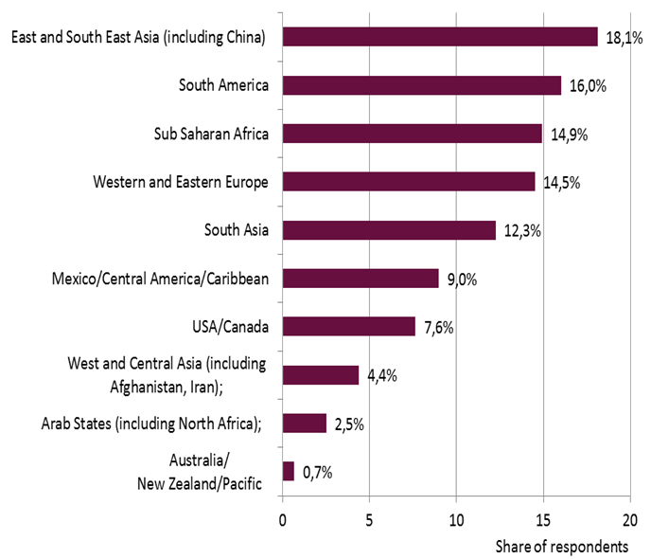
Who says so? Respondents by region

Slide 8
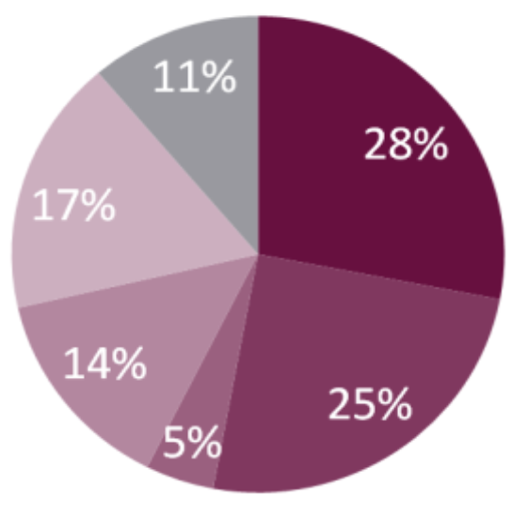
Who says so? Respondents by occupation
UN staff
Private sector
Academia
First UN: 25%
Second UN: 11%
Third UN: 64%
NGOs
International public
organizations
Governments

Slide 9
Challenge #1: Organizational incoherence

Slide 10
Challenge #1: Organizational incoherence
UNwieldy: 30+ organizations, numerous governance arrangements, too much bureaucracy
“Too many agencies, some with overlapping responsibilities. Why not merge UNCTAD, ITC, UNDESA, UNDP and UNIDO; WHO and UNAIDS; FAO, WFP and IFAD? Better organization of the system can halve the number of agencies and increase effectiveness and relevance.”
(Academic, Africa)
“A smaller UNDS….smaller and smarter group of people with genuine interest and capability to work in making the world a better place and show results.” (UN staffer, Europe)
“Harmonize business practices among agencies and simplify bureaucratic procedures that slow the UN down.” (Entrepreneur, Latin America)
“Streamline organization structure and cut out the waste, utilize NGO capacity more.” (Entrepreneur, Africa)

Slide 11
Challenge #1: Organizational incoherence
UNcentered: HQs in 15 countries, 1,000+ country and regional offices
“Create a unified UN Development System…with a single set of administrative and financial norms, a single information system, a single programme at the country level….”
“An internationally respected development figure as its president”
(NGO representative, Europe)
“Apply Delivering as One model in all countries which have a UN presence”
(UN Staffer, Africa)

Slide 12
Challenge #1: Organizational incoherence
Highly dispersed funding mechanism
“Donors agreeing to fund in a holistic way, and donors and host governments agreeing on a single format and system for reporting on expenditure and outcomes/impact.” (NGO, Europe)
“There are too many agencies competing for funds from same donors to fulfil each agency mandate. This leads to inefficient and ineffective programme design and implementation and increases transaction costs.”
(Government official, Latin America)

Slide 13
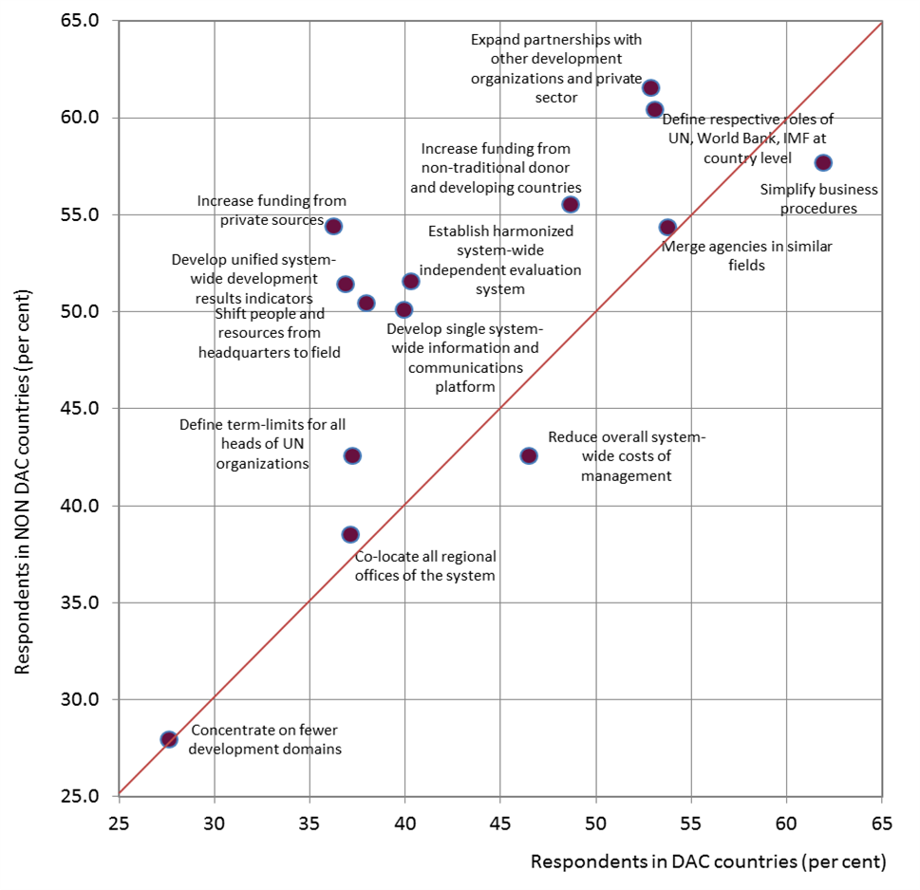
Challenge #1: needed short-term changes
The South has stronger views than the North on change

Slide 14
Challenge #1: country priorities
 | 1st UN | 2nd UN | 3rd UN
 | Governments | UN | International organizations | Nongovernmental organizations | Private Sector | Academia
Top priorities | Single UN Office | Single UN leader per country | Single UN leader per country | Single UN leader per country | Single UN leader per country | World Bank included in One UN
 | Single UN leader per country | Single UN Office | Single UN Office | Single UN Office | Single UN Office | Single UN leader per country
 | World Bank included in One UN | World Bank included in One UN | My Single UN programme per country | World Bank included in One UN | World Bank included in One UN | Single UN Office
 | Single UN programme per country | Single UN programme per country | Single UN fund per country | Single UN fund per country | Single UN programme per country | Single UN programme per country
 | Single UN fund per country | Single UN fund per country | World Bank included in One UN | Single UN programme per country | Single UN fund per country | Single UN fund per country

Slide 15
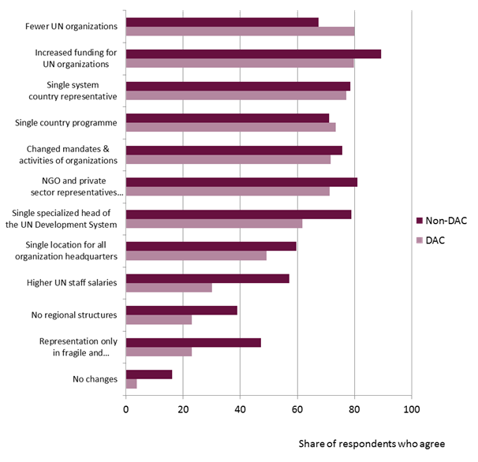
Challenge #1: long-term change

Slide 16
Challenge #2: UN irrelevance

Slide 17
Challenge #2: UN irrelevance
The UN is declining in relative importance
Multilateral assistance shares
* Including new global funds

Slide 18
Challenge #2: UN irrelevance
Other international organizations do it better
“Given better capabilities in other parts of international development system (e.g., IMF, World Bank, regional development banks) the UN should exit from all activities that these agencies undertake. The UN should then focus on what it can do best.”
(NGO, Asia)

Slide 19
Challenge #2: UN irrelevance
Setting technical norms and standards: is it the exclusive preserve of inter-governmental organisations?
Industrial standards: Not UNIDO, but ISO (International Organization for Standardization)
Internet domains: Not ITU, but ICANN (Internet Corporation for Assigned Names and Numbers)

Slide 20
Challenge #2: UN irrelevance
Research, statistics and information: others do it better?
World Bank: World Development Indicators
Regional development banks: Regional economic surveys
World Resource Institute: World Resources reports
World Trade Organization: World Trade Report, World Trade Statistics

Slide 21
Challenge #2: UN irrelevance
International cooperation: when all 193 countries have a “veto” there is gridlock
How many more Conferences of the Parties will it take to get an agreement on climate change (17 and counting…)
Why was the UN ignored during the 2007 global financial crisis (while G20 and WEF seemed relevant)?

Slide 22
Challenge #2: UN irrelevance
UN technical assistance: less is less
In 105 developing countries, UN TA is less than 20% of the total
In 61 developing countries, UN TA is less than 10%

Slide 23
Challenge #2: UN irrelevance
UN technical assistance: different from bilateral?
“Reduce donor influence”
(2012 Survey)

Slide 24
Challenge #2: UN irrelevance
Is the UN relevant in all development domains?

Slide 25
Challenge #2: UN irrelevance
Are all the agencies considered relevant?

Slide 26
Challenge #2: UN irrelevance

Slide 27
Challenge #3: Vested interests
Is the UN development system “too friendly to fail”?

Slide 28
Challenge #3: Vested interests
Reforms of the Development System have been tried. For example…..
1969: Study of the Capacity of the UNDS (Jackson Report)
1975: New UN Structure for Global Economic Cooperation (Gardner Report)
1995: Our Global Neighbourhood (Carlsson, Ramphal)
2006: Delivering as One

Slide 29
Challenge #3: Vested interests
But reforms fall short because of…
“Intergovernmental gridlock”
Staff conservatism
Multiple governance
Funding patterns
Absence of results

Slide 30
So…..making change happen

Slide 31
First UN (Governments) can:
1. Take lessons from the evidence
2. Agree to pool funding

Slide 32
Second UN (Secretariats) can:
1. Complete the DAO recommendations
2. Use the post-MDG period to re- think UN development role
3. Improve remuneration and recruitment

Slide 33
Third UN (“the peoples”) can:
1. Continue survey and research to demonstrate the advantages of reform
2. Build global networks to advocate change

Slide 34
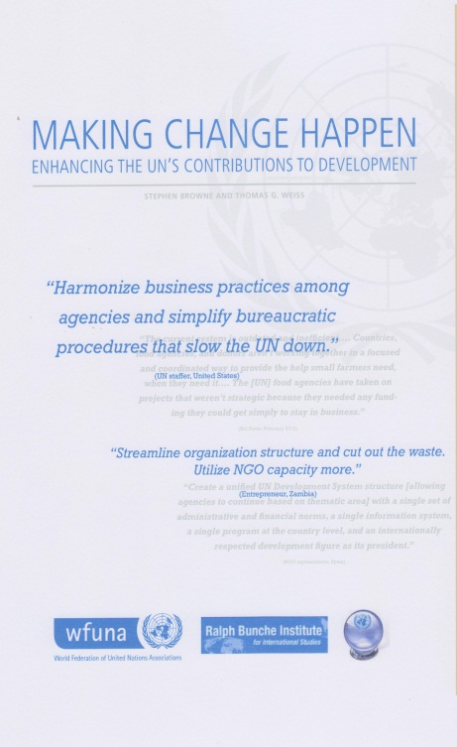
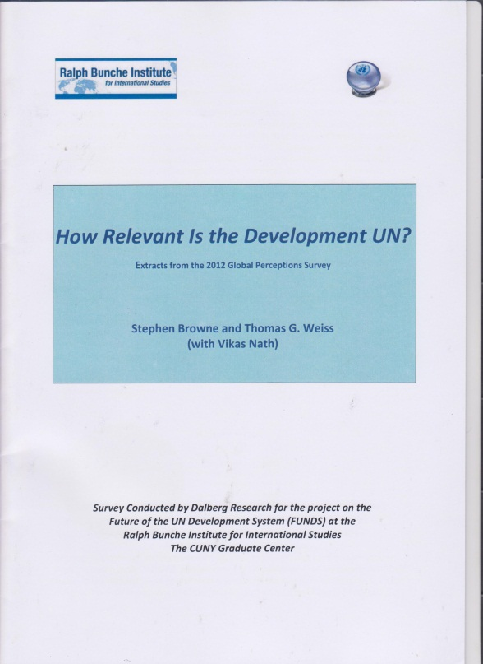
Copies of the reports: www.FutureUN.org

